Slide 1
Realization of SDN using Opendaylight

Slide 2
RANJITHA RATCHAGAN GRADUATE STUDENT MASTERS IN TELECOM ENG & MANAGEMENT UNIVERSITY OF MARYLAND, COLLEGE PARK

Slide 3

Note :I am a video, play me

Slide 4
Use Cases
QoS-Enabled Adaptive Video Streaming
Priority QoS for Critical Applications
Dynamic Network Bandwidth Allocation
Bandwidth on Demand (BWoD)
On-Demand Personal Virtual Networks
Simplified Customer Premise Equipment

Slide 5
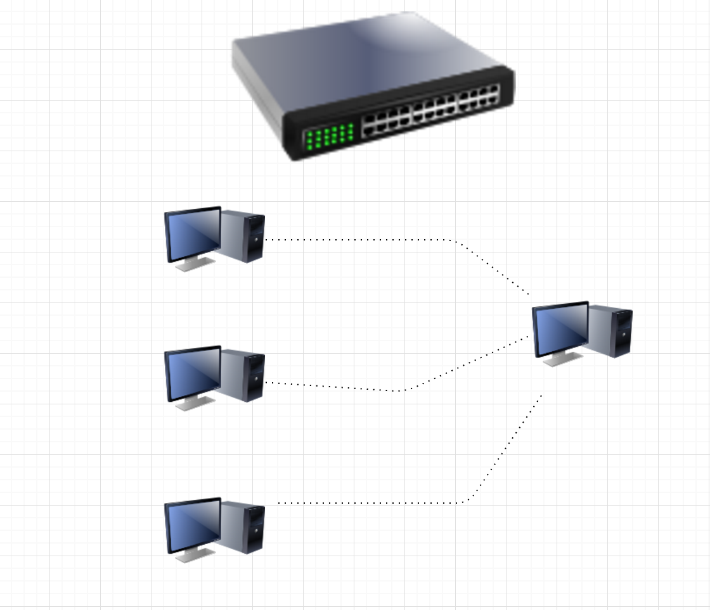
QoS-Enabled Adaptive Video Streaming

Slide 6
QoS-Enabled Adaptive Video Streaming
Flows were pushed through the entire path between source and destination
Client will provide source and destination IP/MAC address
Application will choose port
Streamming was demonstrated using a VLC on the destination host
Host with the SDN path, showed high quality in the video.

Slide 7

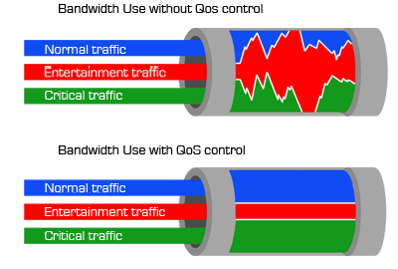
To acchieve Qos,
Created separate queues(q0,q1) for the dedicated host.
Flows with specified bandwidth were pushed
QoS-enabled adaptive video streaming eliminates packet loss, delay & jitter, ensuring quality viewing experience for the customer

Slide 8
Use-case : PCMM

Slide 9
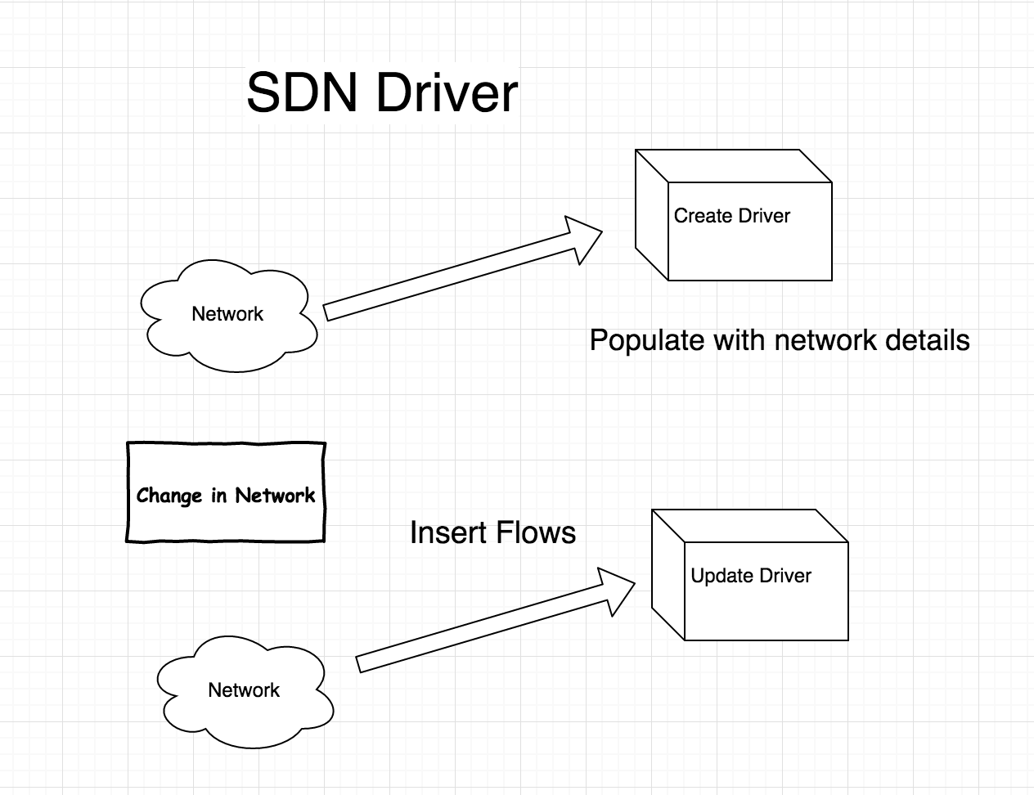
Flow Based REST API

Slide 10
Network Orchestration project
SDN Driver through RESTFul Webservices
Application communicates with the SDN Controller
Fetches the network information through REST API
Network Data is modeled into application

Slide 11
CONTROL FLOW OF THE DRIVER

Slide 12
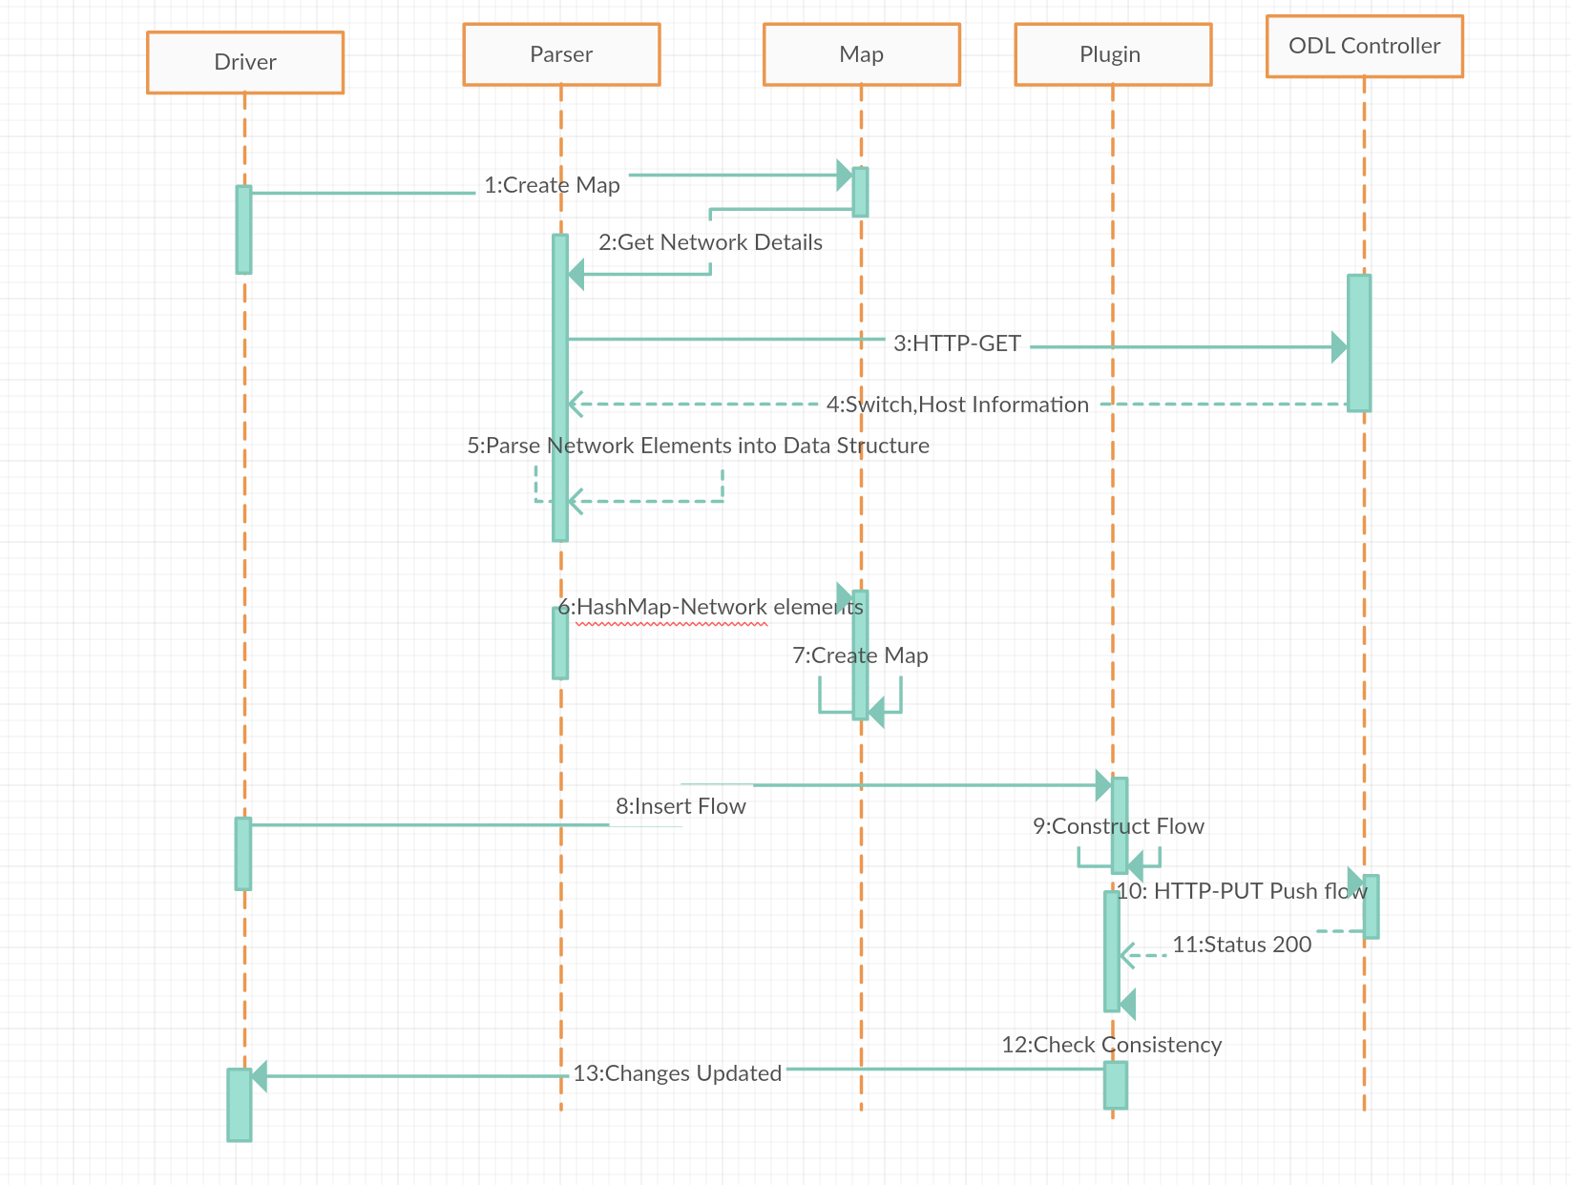

Slide 13
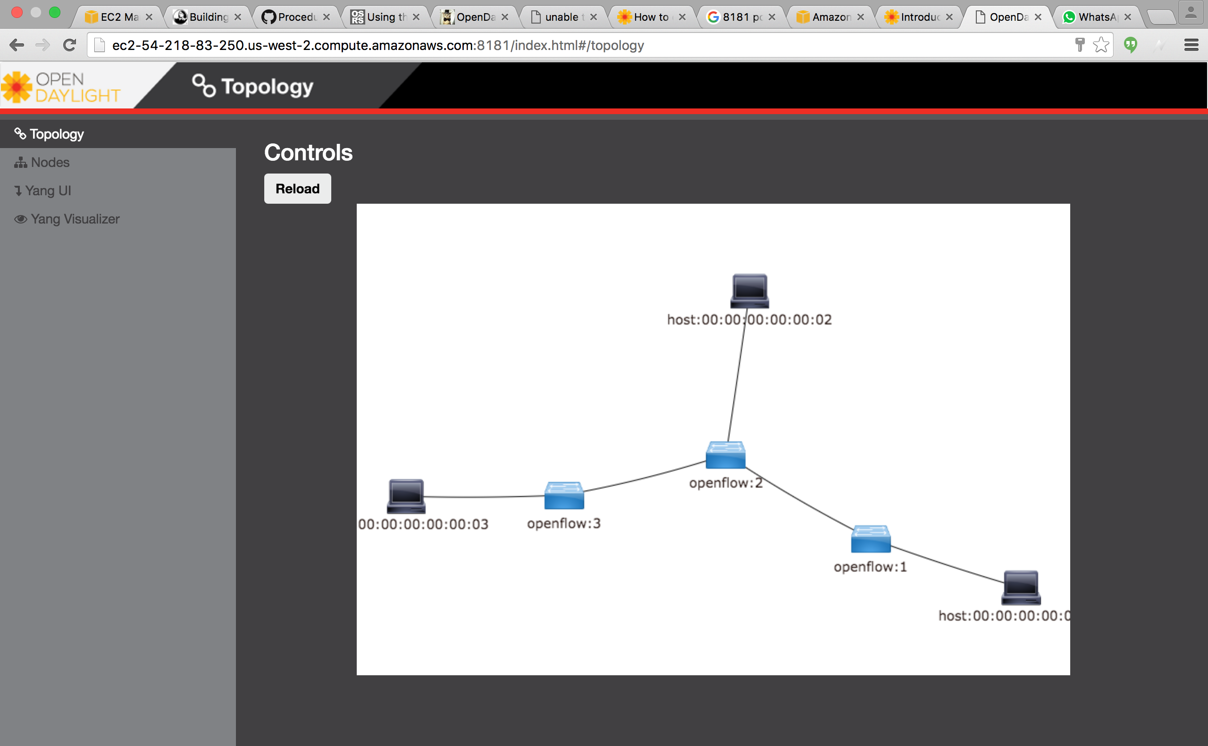
Example Topology

Slide 14
MAJOR CHALLENGES FACED: Parse network elements into a data structure Reason: Multiple fields for a flow entry Construction of a flow No definite documentation for a syntax of a flow Inconsistency between Operational & Config dataStore

Slide 15
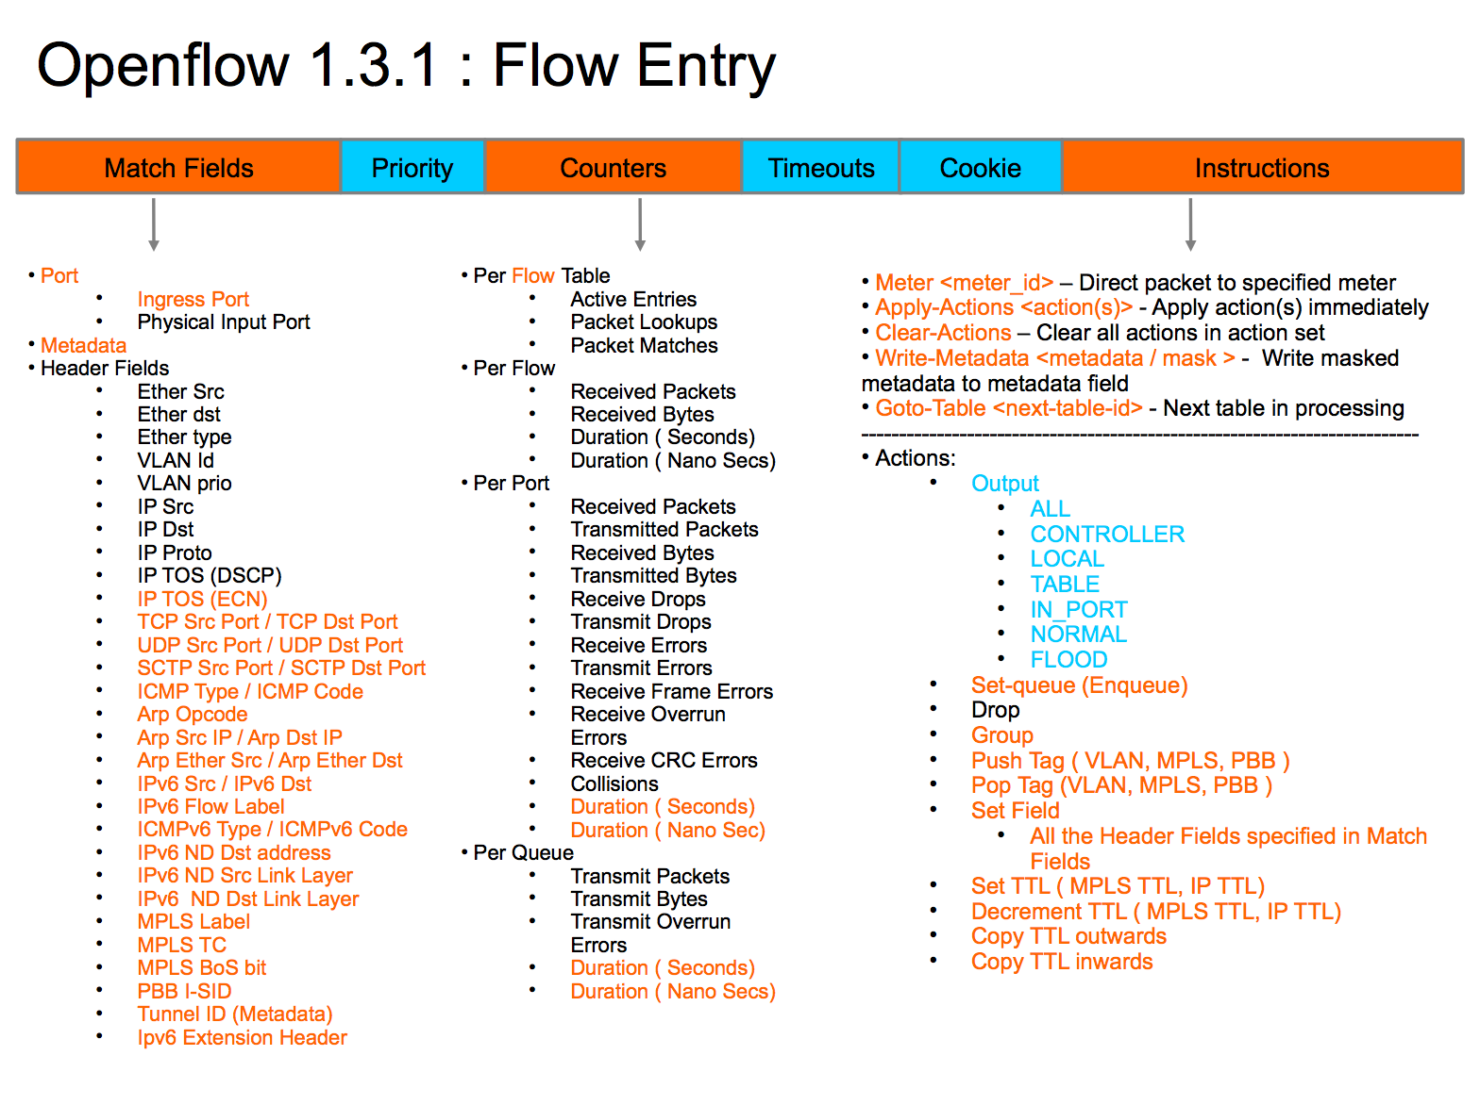

Slide 16
Example Flow Entry
http://localhost:8181/restconf/config/opendaylight-inventory:nodes/node/openflow:1/table/0/flow/0
<flow xmlns="urn:opendaylight:flow:inventory">
<id>0</id>
<strict>true</strict>
<out_port>10</out_port>
<idle-timeout>0</idle-timeout>
<barrier>false</barrier>
<hard-timeout>0</hard-timeout>
<table_id>0</table_id>
<priority>2</priority>
<cookie>10</cookie>
<instructions>
<instruction>
<order>1</order>
<apply-actions>
<action>
<order>1</order>
</action>
</apply-actions>
</instruction>
</instructions>
<out_group>2</out_group>
<installHw>false</installHw>
<match>
<ethernet-match>
<ethernet-type>
<type>2048</type>
</ethernet-type>
</ethernet-match>
<ipv4-destination>10.0.0.1/24</ipv4-destination>
</match>
<cookie_mask>10</cookie_mask>
<flow-name>FooXf22</flow-name>
</flow>
Note: Use vookie_mask to push consistent flows across datastores

Slide 17
JSON Format:
{
"flow": [
{
"id": "0",
"match": {
"ethernet-match": {
"ethernet-type": {
"type": "2048"
}
},
"ipv4-source": "10.0.0.1/24"
},
"instructions": {
"instruction": [
{
"apply-actions": {
"action": [
{
"order": "1",
"flood-action": {}
}
]
},
"order": "1"
}
]
},
"cookie_mask": "10",
"out_port": "10",
"out_group": "2",
"flow-name": "FooXf22",
"installHw": "false",
"barrier": "false",
"strict": "true",
"priority": "2",
"idle-timeout": "0",
"hard-timeout": "0",
"cookie": "10",
"table_id": "0"
}
]
}

Slide 18
Future work
A Generic JavaEE framework that pushes flows into the Network
Priority QoS for Critical Applications

Slide 19
SWOT SDN
// yet to be added, short video on SDN community @ UMD & Wipro(featuring colleagues & friends)

Slide 20
Thank you Ranjitha Ratchagan ranjitha@umd.edu Ph: 240-644-3301

